Slide 1
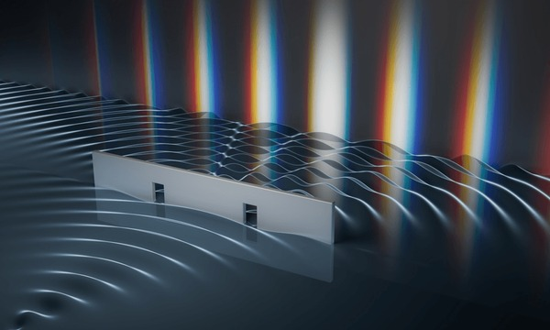
Double-Slit Experiment

Slide 2
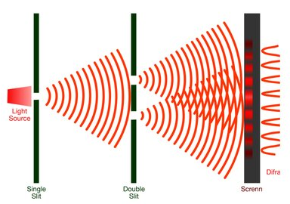
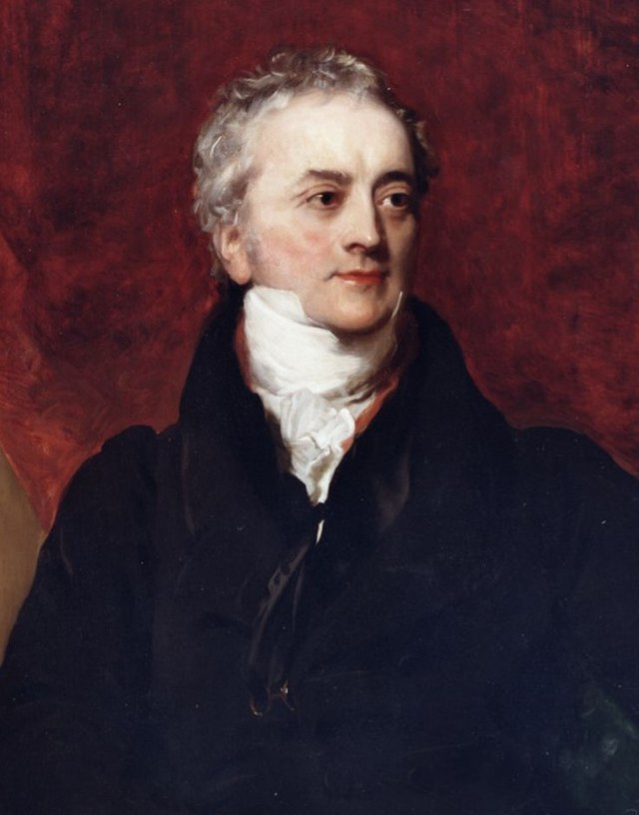
What is the Double-Slit Experiment?
Interference pattern
Thomas Young

Slide 3
How do system parameters affect the interference pattern?

Slide 4
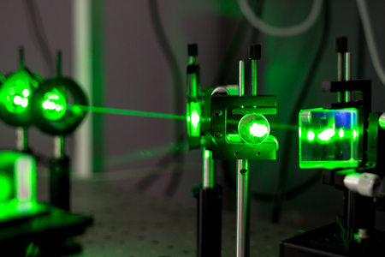
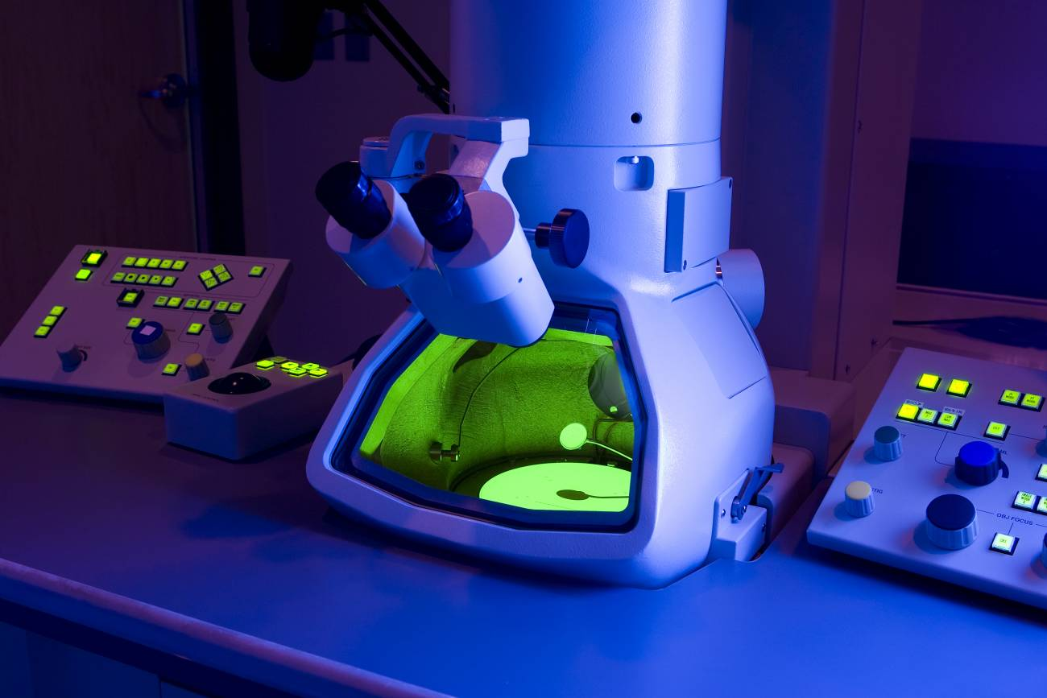
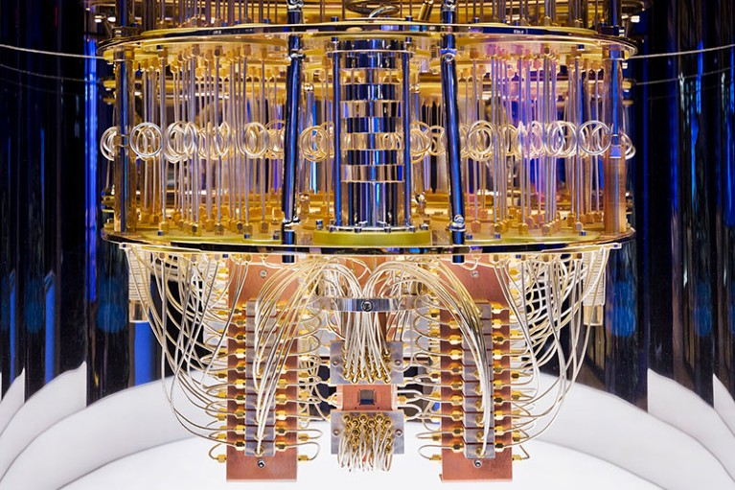
Why was this discovery important?
Laser
Electron microscope
Quantum computer

Slide 5
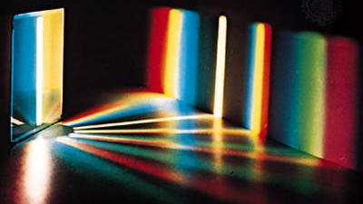
Thank you for your attention!

